Slide 1

Chinese
Zodiac
生肖

Slide 2
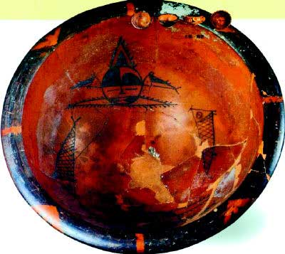
the adoration and veneration of animals
during prehistoric times

Slide 3
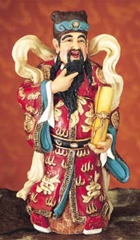
Chinese God

Slide 4
Chinese
Zodiac
生肖

Slide 5
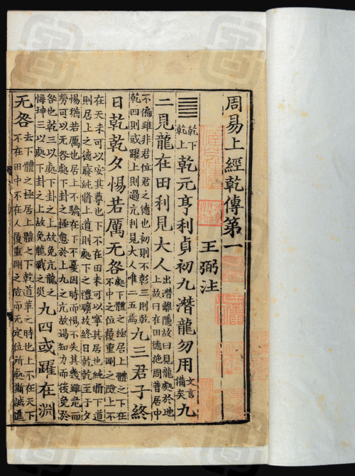
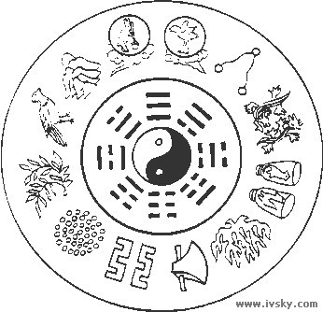
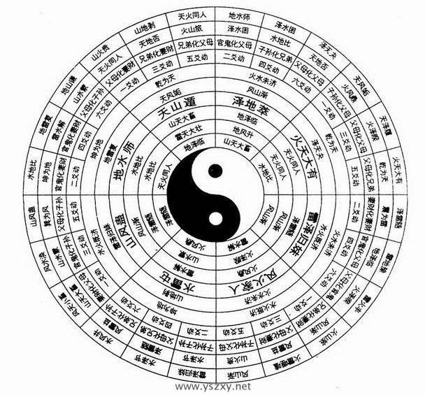
The Bood of Yi Jing

Slide 6
The Outer Animal
The Outer Animal is the animal assigned to all persons born within any given year
Rat | Feb 02 1984 - Feb 19 1985
Ox | Feb 20 1985 - Feb 08 1986
Tiger | Feb 09 1986 - Jan 28 1987
Rabbit | Jan 29 1987 - Feb 16 1988
Dragon | Feb 17 1988 - Feb 05 1989
Snake | Feb 06 1989 - Jan 26 1990
Horse | Jan 27 1990 - Feb 14 1991

Slide 7
The Inner Animal
An individual's monthly animal sign is called their inner animal
Feb 04 - Mar 05 | 1st -寅 Tiger
Mar 06 - Apr 04 | 2nd - 卯 Rabbit
Apr 05 - May 04 | 3rd - 辰 Dragon
May 05 - June 05 | 4th - 巳 Snake
Jun 06 - Jul 06 | 5th - 午 Horse
Jul 07 - Aug 06 | 6th - 未 Sheep
Aug 07 - Sep 07 | 7th - 申 Monkey
Sep 08 - Oct 07 | 8th - 酉 Chicken
Oct 08 - Nov 06 | 9th - 戌 Dog
Nov 07 - Dec 06 | 10th - 亥 Pig
Dec 07 - Jan 05 | 11th - 子 Rat
Jan 06 - Feb 03 | 12th - 丑 Ox

Slide 8
The Secret Animal
The secret animal is connected wtih a person’s birth hour
11:00am - 01:00am | 子 rat
01:00am- 03:00am | 丑 ox
03:00am - 05:00am | 寅 tiger
05:00am - 07:00am | 卯 rabbit
07:00am - 09:00am | 辰 dragon
09:00am - 11:00am | 巳 snake
11:00am - 1:00pm | 午 horse
1:00pm - 3:00pm | 未 sheep
3:00pm - 5:00pm | 申 monkey
5:00pm - 7:00pm | 酉 chicken
7:00pm- 9:00pm | 戌 dog
9:00pm - 11:00pm | 亥 pig

Slide 9

The Rat--老鼠(lǎo shǔ)
People born in this year are
presumed to be intelligent
and popular.
1924, 1936, 1948, 1960,
1972, 1984, 1996, 2008

Slide 10

The Ox--牛（niú）
People born in this year are
presumed to be methodical
and conscientious workers.
1913, 1925, 1937, 1949,
1961, 1973, 1985, 1997, 2009

Slide 11

The Tiger--老虎（lǎo hǔ）
People born in this year are presumed to be courageous and charismatic.
1914, 1926, 1938, 1950, 1962, 1974, 1986, 1998, 2010

Slide 12

The Rabbit--兔子（tù zi）
People born in this year are presumed to be well
mannered pacifist.
1915, 1927, 1939, 1951, 1963, 1975, 1987, 1999, 2011

Slide 13

The Dragon--龙（lóng）
People born in this year are
presumed to be ambitious
and has the quality of
Leadership.
1916, 1928, 1940, 1952,
1964, 1976, 1988, 2000, 2012

Slide 14

The Snake--蛇（shé）
People born in this year are presumed to have active mind and enjoy challenges.
1917, 1929, 1941, 1953, 1965, 1977, 1989, 2001, 2013

Slide 15

The Horse--马（mǎ）
People born in this year are presumed to be charming and enjoy being the center of attention
1918, 1930, 1942, 1954, 1966, 1978, 1990, 2002, 2014

Slide 16

The Sheep--羊（yáng）
People born in this year are presumed to be creative and have easy-going nature.
1919, 1931, 1943, 1955, 1967, 1979, 1991, 2003, 2015

Slide 17

The Monkey--猴子（hóuzi）
People born in this year are presumed to be imaginative and curious.
1920, 1932, 1944, 1956, 1968, 1980, 1992, 2004, 2016

Slide 18

The Chicken--鸡(jī)
People born in this year are presumed to be flamboyant and well-read.
1921, 1933, 1945, 1957, 1969, 1981, 1993, 2005, 2017

Slide 19

The Dog--狗（gǒu）
People born in this year are presumed to be honorable and have strong senses of fair play.
1922, 1934, 1946, 1958, 1970, 1982, 1994, 2006, 2018

Slide 20

The Pig--猪（zhū）
People born in this year are presumed to be honest and have understanding nature.
1923, 1935, 1947, 1959, 1971, 1983, 1995, 2007, 2019

Slide 21
The Tiger--老虎（lǎo hǔ）
Tiger people are brave, powerful, loyal, intelligent, competent, and stubborn. Tigers make great friends. Tiger people tend not to respect their elders and that can get them in a lot of trouble.

Slide 22
The Rabbit--兔子（tù zi）
Rabbit people are lucky, happy, independent, affectionate, bright, ambitious, and trustworthy. Rabbit people have little interest in learning to appear smart. They simply like to know how things work.

Slide 23
The Dog--狗（gǒu）
Dog people are loyal friends, quick to learn, eager to please, and always try to do their best. They prefer to be with people they know and like. Dog people cannot stand injustice.

Slide 24
Chinese
Zodiac
生肖

Slide 25
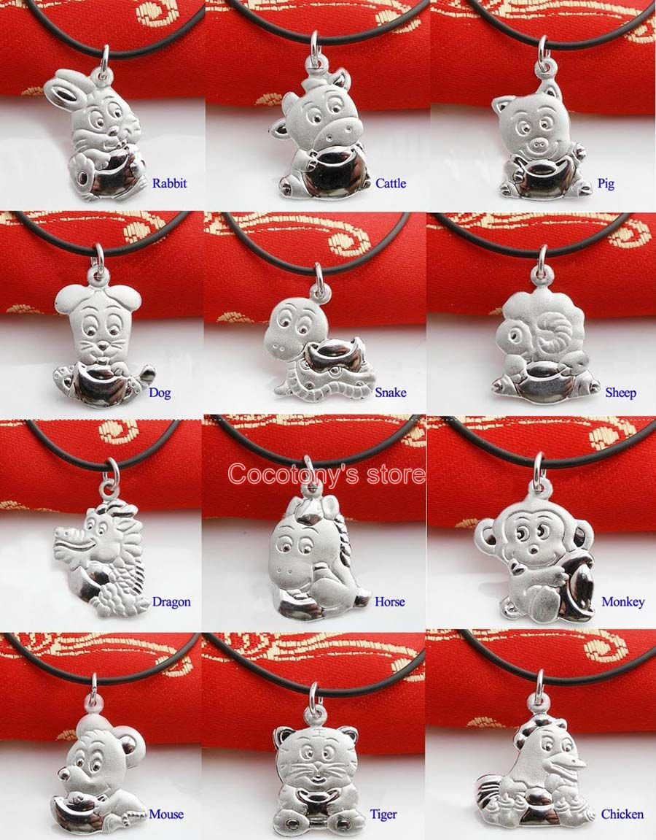
Chinese Zodiac Gifts

Slide 26
Chinese
Zodiac
生肖

